Slide 1


SMART INDIA HACKATHON 2022

Slide 2
MINISTRY / ORGANIZATION :
Defence Research and Development Organisation (DRDO), Ministry of Defence
PS CODE :
NR1168
PROBLEM STATEMENT TITLE :
Develop Application to regulate Private health care sector in India from exploiting people during medical emergencies and pandemic situations
TEAM NAME :
TEAM LEADER NAME :
Amruta Kashikar
INSTITUTE CODE :
INSTITUTE NAME :
Cummins College of Engineering For Women , Nagpur
THEME NAME :
MedTech / BioTech / HealthTech

Slide 3
Idea / Solution Prototype
Providing Login Page for Hospitals / Admin and Registration Page for Hospitals
Registration of hospital using their username and password.
Admin panel to verify the hospital and then activate their account.
Users can view medical facilities provided by the respective hospitals as well as the prices of medical facilities.
Hospitals can add a list of medical facilities that are provided and their prices.
Users can also raise a complaint if the hospital charges more amount than mentioned in the application.
Admin will be able to see the list of complaints that the users have made regarding a particular hospital.

Slide 4
TECHNOLOGY STACK
ANDROID EMULATOR / DEVICE
ANDROID 5.0 LOLIPOP AND Above
FIREBASE
JAVA
As most of the Indians use android devices we have decided to create an android application
footer

Slide 5

Dependencies
User
Hospital
Cloud Service by Firebase
Android Users
Show Stoppers
Lack of Users
Lack of Hospitals

Slide 6
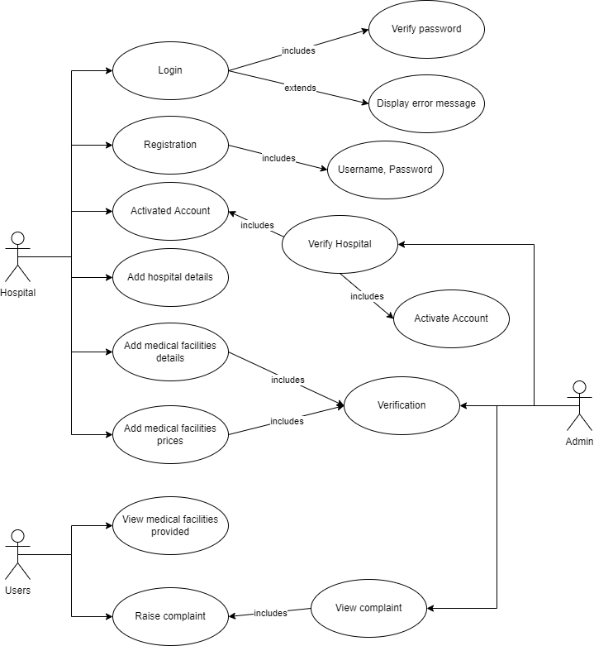
Use Case Diagram

Slide 7
THANK YOU
Team members
Srimoyee Dutta
Vaishali Pathania
Amruta Kashikar
Aditi Bhardwaj
Harshal Jodangade
Divya Wandhare

